Slide 1
Information Security Risk & Compliance (ISRC)
BloodHound at Bayview
Henry Post - May 2026

Slide 2

Meta slide
Who are you?
  Nice to meet you! I’m Henry Post. I lead AppSec and I’ve been at Bayview for 3 years, US Bank for 4 years previously. I love baking, cooking, fighting games, gardening, weightlifting, and am currently studying for the OSCP exam (hacking exam). I specialize in Application Security and penetration testing. My personal site is https://drakonix.systems/ if you’re curious about other projects I’ve worked on. I host some infra there for animal shelters.
How did you generate your diagrams?
  I use Mermaid to generate diagrams. If I could, I would use LaTeX or pure Markdown plus pandoc CLI for deterministic formatting for this entire PPTX.
    https://github.com/Mermaid-Chart/vscode-mermaid-chart
Are there guides related to AppSec?
  Yes! There are many below.
    https://bayview0.sharepoint.com/sites/ApplicationSecurity

Slide 3
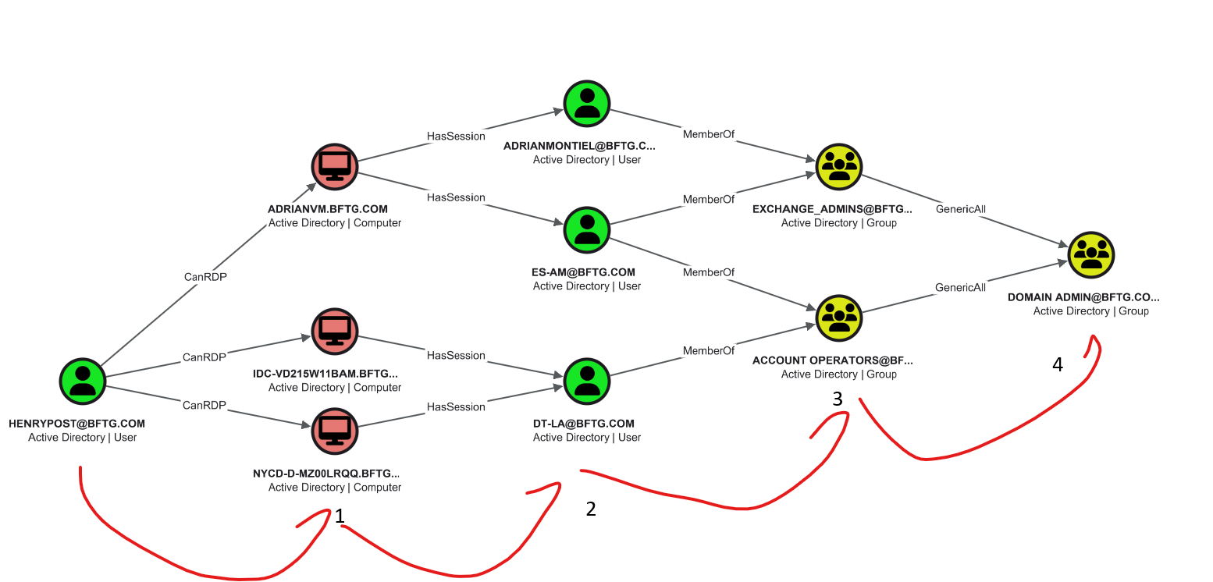
What is BloodHound? 1
BloodHound is a tool that shows you vulnerabilities between relationships in (originally) Active Directory.
  It uses a graph-based backend to store relationships. “neo4j” is the graph backend for the nerds in the audience.
Example: Henry Post to Domain Admin
  I’d have to RDP (1), steal a user session (2), and then I get Domain Admin (3,4).

Slide 4
What is BloodHound? 2: What have we done?
Originally, I got bored, so I started playing around with BloodHound in my home lab, using docker-compose deploy, and I thought,
  “What if we used BloodHound at my work?”
Big thank you to Tommy Roberson for the support on this!
  Because of Tommy’s and the entire IAM team’s work, we have massively reduced our attack surface in AD.
We originally had 100k+ more traversable paths to get domain admin.
  Thanks to Tommy’s work, and the AD team and IAM team, we have reduced total attack paths by probably 90% or so.
Next slide shows stats.
The hard work involved de-tangling overly permissive groups, fixing AD Certificate abuse, creating newer less permissive groups, and removing super-admins or generally overly permissioned individual user/service accounts.

Slide 5
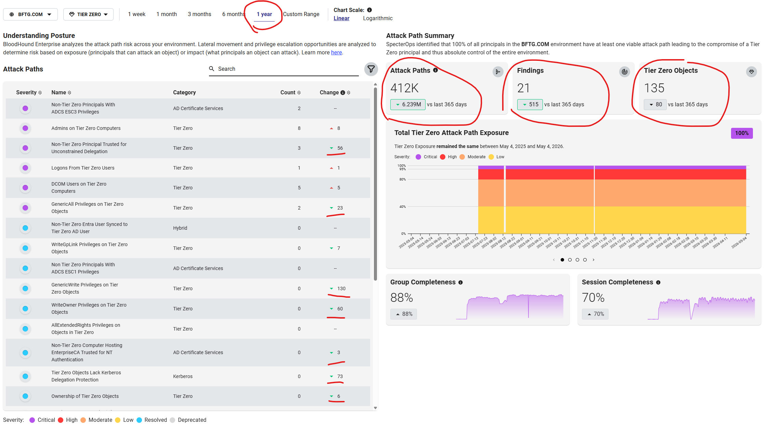
What is BloodHound? 3: Stats?

Slide 6
Neat, what else can BloodHound do?
Well, it’s a graph-backed data engine, so, quite a lot: Enter “OpenGraph”
https://bloodhound.specterops.io/opengraph/library#github
  Git (code version control)
  1password (cred store)
  Ansible (fleet software deploy tool)
  Amazon Web Services (AWS)
  CyberArk (cred store)
  Generic Network/LAN “NetworkHound”
  MSSQL (database lang)
  Microsoft Exchange
  Et cetera: There are many more.

Slide 7
Neat, what else can BloodHound do? 2 – GitHound
There are some easy wins for us to integrate, namely, Git – GitHound.
https://bloodhound.specterops.io/opengraph/library#github
Git (code version control) – GitHound
  https://github.com/SpecterOps/GitHound
We can use this to interrogate if our GitHub/BitBucket RBAC (Role-based access control) has any vulnerabilities in that it’s too permissive, and could be useful to an attacker…

Slide 8
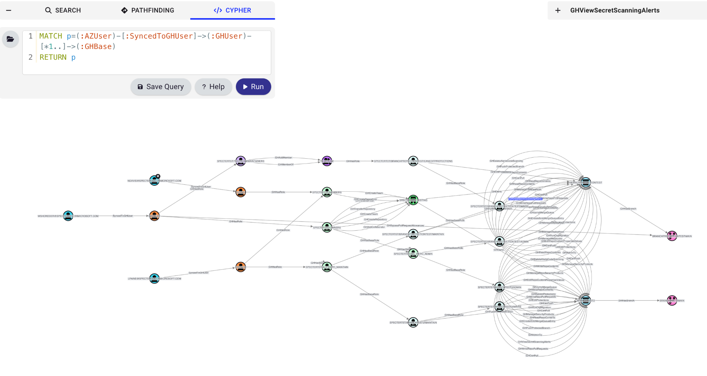
Neat, what else can BloodHound do? 3 – GitHound

Slide 9
BloodHound: FAQ and Questions
What does BloodHound scan in Active Directory?
  Almost everything: RDP sessions, user roles, AD certificates, relationships, group relationships, etc.
Do we pay for this tool?
  Yes, we are currently licensed for enterprise edition.
Do new collectors cost money?
  No, all new OpenGraph collectors are free. The only cost is effort/time: the credentials to provision and complexity of setting them up.
How does data collection work?
  I run a VM with “sensors” that scrape data from Active Directory and send it to BloodHound once every 2 hours, all the time. It’s lightweight enough that this doesn’t cause issues.
Are you going to use GitHound?
  Yes, it’s on my roadmap. Wing Chau generously gave me creds to test with. <presenter: show roadmap to audience>
<Please feel free to ask a question>

